Slide 1
IMPLEMENTING A SCIENTIFIC CALCULATOR IN C++ WITH OBJECT- ORIENTED PROGRAMMING

Slide 2
INDEX→
PROJECT BY IT FY STUDENTS –
Parth Mirajkar
RBT23IT066
Ritesh Patil
RBT23IT069
Prasad Satpute
RBT23IT073
Rahul Bhosale
RBT23IT084
INTRODUCTION
HARDWARE-SOFTWARE REQUIREMENTS
PROBLEM STATEMENT
FLOW-CHART
CONCLUSION & CODE PDF

Slide 3

INTRODUCTION
This presentation will discuss the implementation of a scientiﬁc calculator in C++ using object- oriented programming. We will explore the key features and design principles for creating a robust and efﬁcient calculator application.

Slide 4

HARDWARE-SOFTWARE REQUIREMENTS
Software- Windows 10/11
Processor- intel i5 gen 13
Size- 70 kb
IDE- Vscode

Slide 5

PROBLEM STATEMENT
"Design and develop a scientific calculator software application capable of performing complex mathematical operations, including trigonometric functions, logarithms, arithmetic exponentials, and statistical calculations, with a user-friendly interface and high accuracy. The calculator should support both basic and advanced mathematical functions, providing a reliable tool for scientists, engineers, students, and professionals in various fields."

Slide 6

OBJECT-ORIENTED PROGRAMMING
Object-oriented programming (OOP) is a programming paradigm based on the concept of objects, which can contain data and code. In C++, OOP allows for the creation of classes and objects to represent real-world entities and their interactions.

Slide 7

DESIGNING THE CALCULATOR CLASS
The Calculator class will encapsulate the functionality of the scientiﬁc calculator. It will include methods for performing arithmetic operations, as well as functions for handling trigonometric and logarithmic calculations and many more.

Slide 8
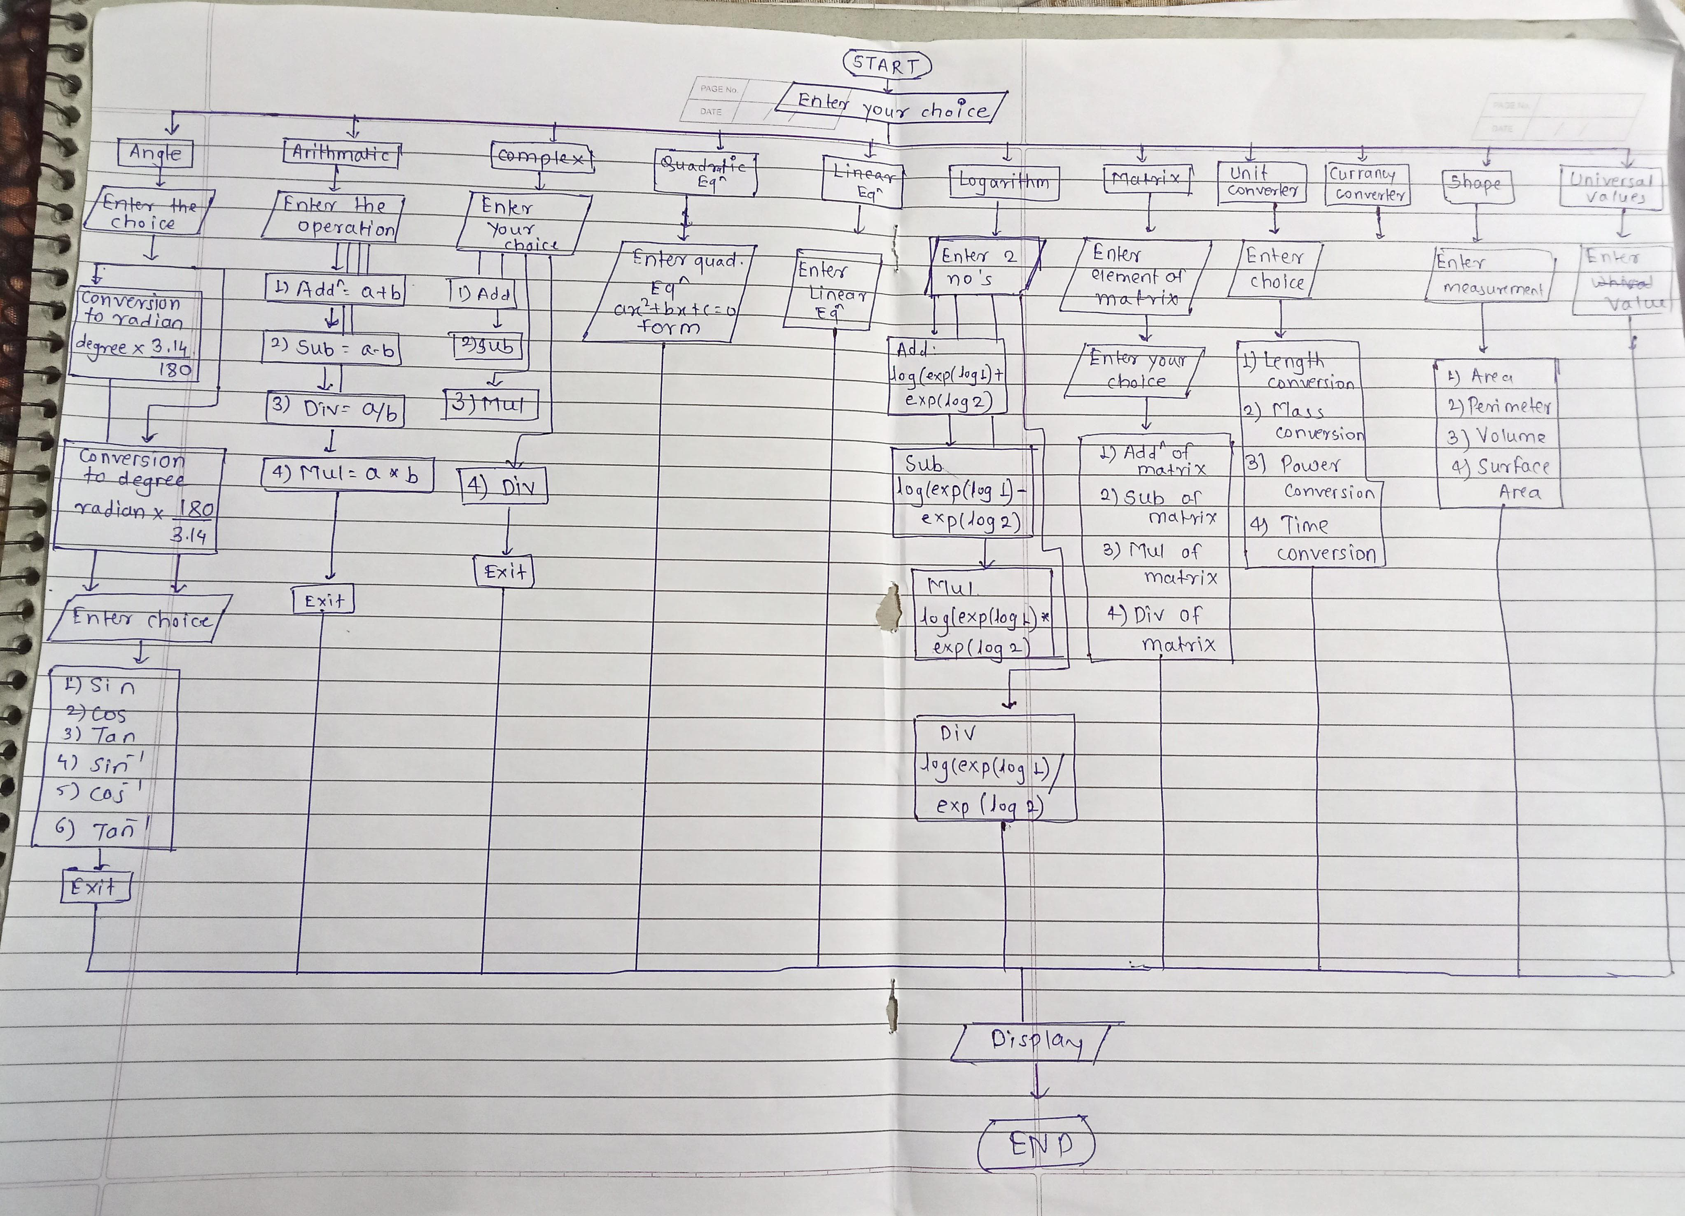


FLOW-
CHART

Slide 9
CONCLUSION
The implementation of a scientiﬁc calculator in C++ with object-oriented programming offers a powerful and ﬂexible solution for handling complex mathematical calculations. By using OOP principles, robust design, and performance optimization, the calculator application provides a valuable tool for scientiﬁc and engineering applications.

Slide 10
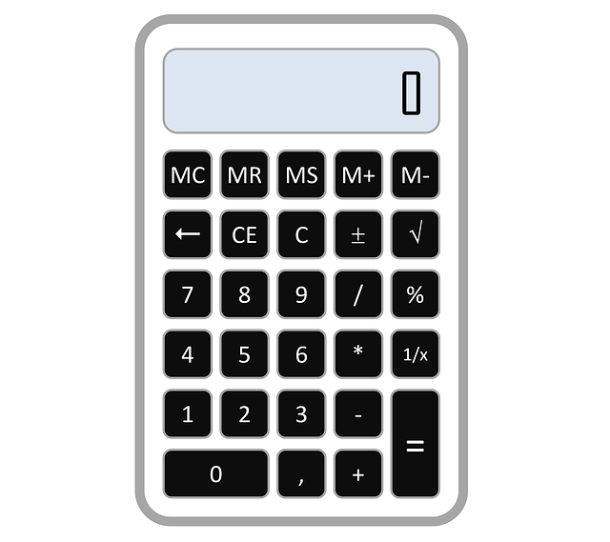


CODE PDF

Slide 11

Thanks!

